Slide 1

Leveraring AI to Analyse the Socio-Economic Impact of
Covid-19 in INDIA
Welcome to the Final Presentation!
Notes:
A Warm Welcome to everyone who have joined the kickoff meeting of Omdena India Chapters First Ever Local Challenge - Leveraging Ai to Analyse the Socio Economic Impact of Covid19 In India

Slide 2

Agenda
Problem statement
Project workflow and pipeline
Data Collection Phase
Modelling Phase
Deployment Phase

Slide 3

The Problem
Our goal is to build a model to analyze the changes of social and economic trends in India due to the outbreak of Covid and correlate various factors that contribute to the rise and fall of the economy in India.
The NLP-based model could then be used to predict the change in future trends in the economy based on these factors.
The sentiment of people is modeled from the historical data which could then be used to predict the real-time sentiment and the factors contributing to that sentiment when a potential third wave or a new outbreak in the society happens.
Other objectives include
Identifying the covid vulnerability in a person through attributes
building computer vision models to early detect the presence of covid through X-ray images or CT scans and classify the severity of Covid-19.

Slide 4
The Learning Outcomes
Collaboration and Communication skills
Problem understanding
Explore the tools required for the project
Brainstorming sessions and weekly meetings as required
Presentation and Walkthroughs
Deployment
Upskilling on required skills of AI field

Slide 5
Project’s Work-flow Pipeline
Input
Data preparation/pre-processing
Modelling
Interactive trackers & Dashboards
Train model on tweets from before and deploy model to get real time sentiment
Any covid related sentiment, vaccine, economy
Time series analysis of covid vs economic change in India
Arima , exponential smoothing , moving average
Task 4
Task 1
Task 3
Twitter hashtag extraction
Image Preprocessing (augmenting, resizing)
NLP data pre-processing, vectorizing text data, filling missing values, segregating chunks of data to single big blob
Tweets extractions via tweets id from the data
Building interactive plots and drawing analysis and correlation matrix between various attributes
Build Interactive map giving real time details of covid cases, total vaccine produces and usage
Task 2
Deploy EDA web app in Heroku
Forecast and Prediction models in Streamlit Share
Dash and Plotly web app for EDA Analyses
Build web app Streamlit for Forecast and Prediction models
Task 7
Task 5
Task 6
Include Image Classification, object detection on CT Scan images
NLP classification model to identify covid based on symptoms
‹#›

Slide 6

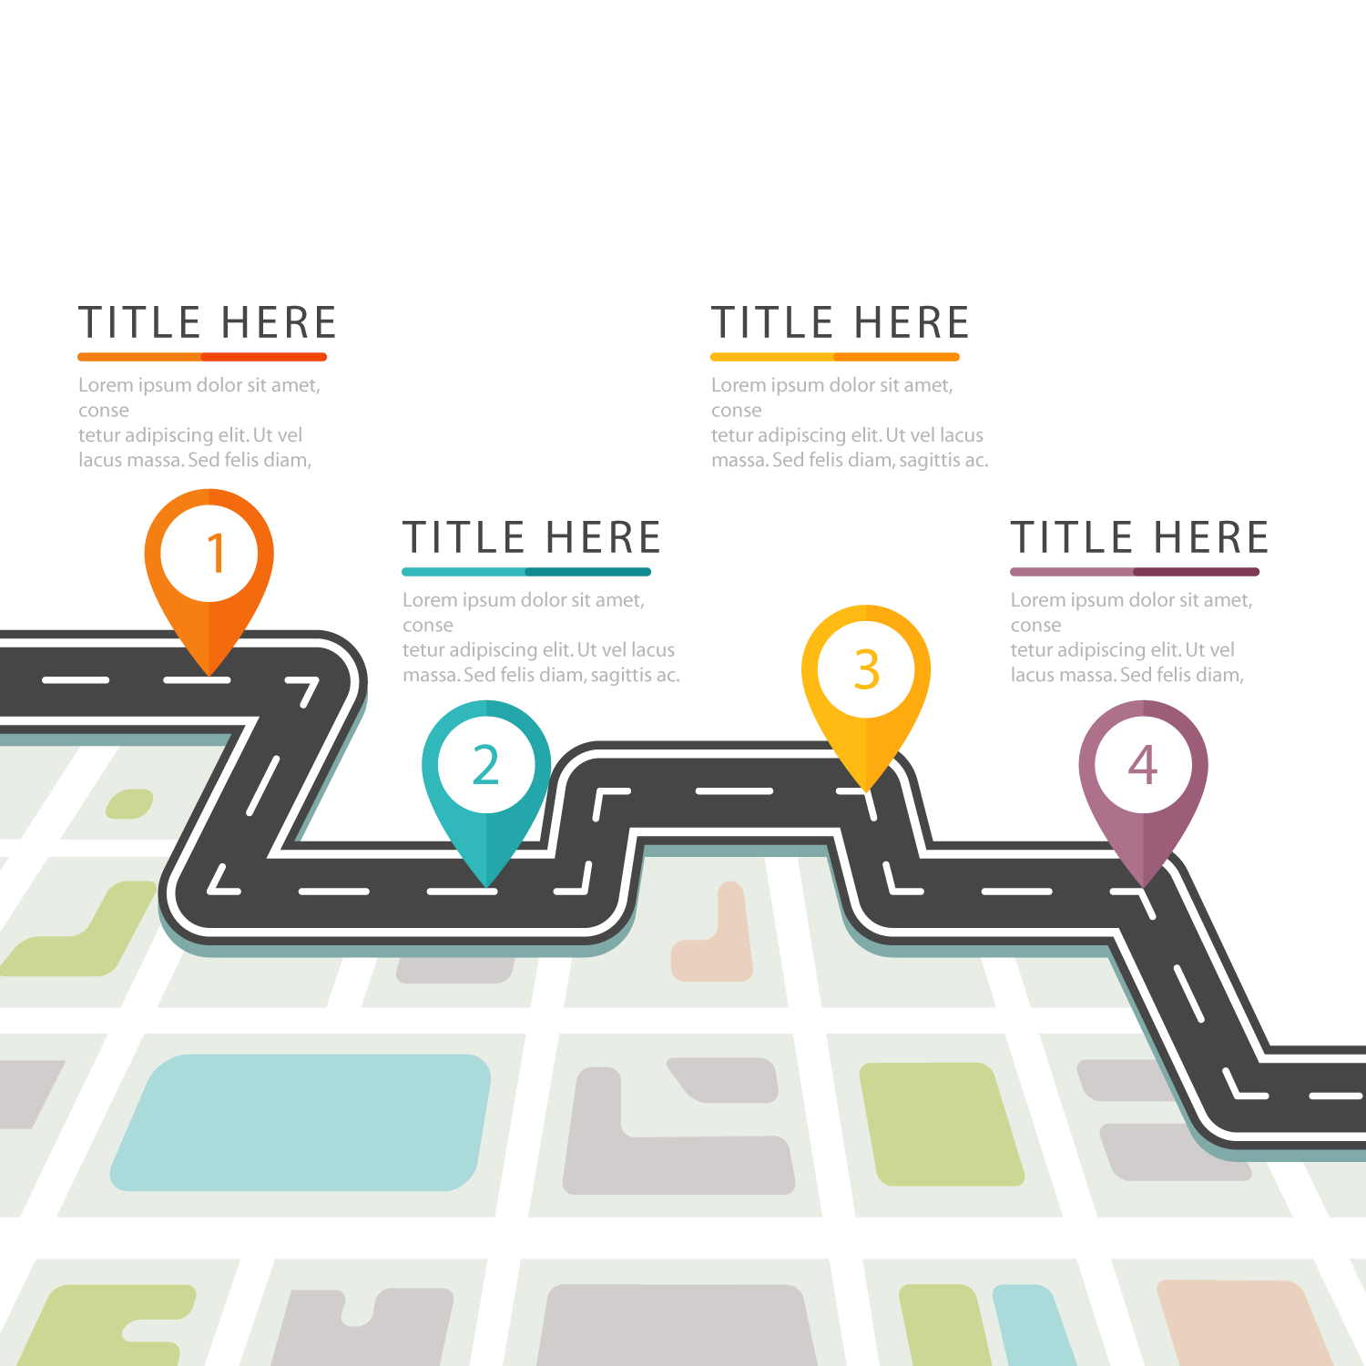
RoadMap of last 4 weeks
WEEK -1
Data Gathering & Collection
Data Pre-processing
WEEK - 3
Sentiment Analysis Model
Image Classification model based on symptoms
Start building Streamlit Web App
WEEK - 2
EDA
Vaccine Tracker
Time Series Analysis
NLP based Classifier
WEEK - 4
Integrating Web App
Deploying Solution in Cloud Platforms
Notes:
Mention about observers and participants

Slide 7

Data Collection Phase

Slide 8

Week 1 - 2
Data Gathering
Resources of the datasets used for this project
Provided with the resource link from Omdena
Added additional relevant sources from the team
Other resources from Kaggle and GitHub
Defined the required fields for each sub tasks
Execution
Proof checking the datasets for any non relevant fields
Cleaned and pre-processed for the next step (EDA)
Data Quality Checks
Collected from Our World in Data and Covid19India resources
Categorised datasets as social and economic factors

Slide 9
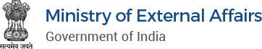

Week 1 - 2
Data Resources
Covid 19 India
Our World in Data via GitHub
MEA
Covid Scans and Images
Unemployment dataset

Slide 10

Data Analysis (EDA)
Planning
Discussions on choosing the relevant datasets for the social and economic impact analysis
Features extraction from the datasets collected through plotting of graphs using tools like plotly, matplotlib and seaborn
Execution
Descriptive data analysis
Extract the relevant fields
Performed EDA steps to derive insights for the above impact analysis
Data Relevancy for ML Model Building through EDA
Pre-processing data for ML Model
Filtered out data that is relevant to model building

Slide 11
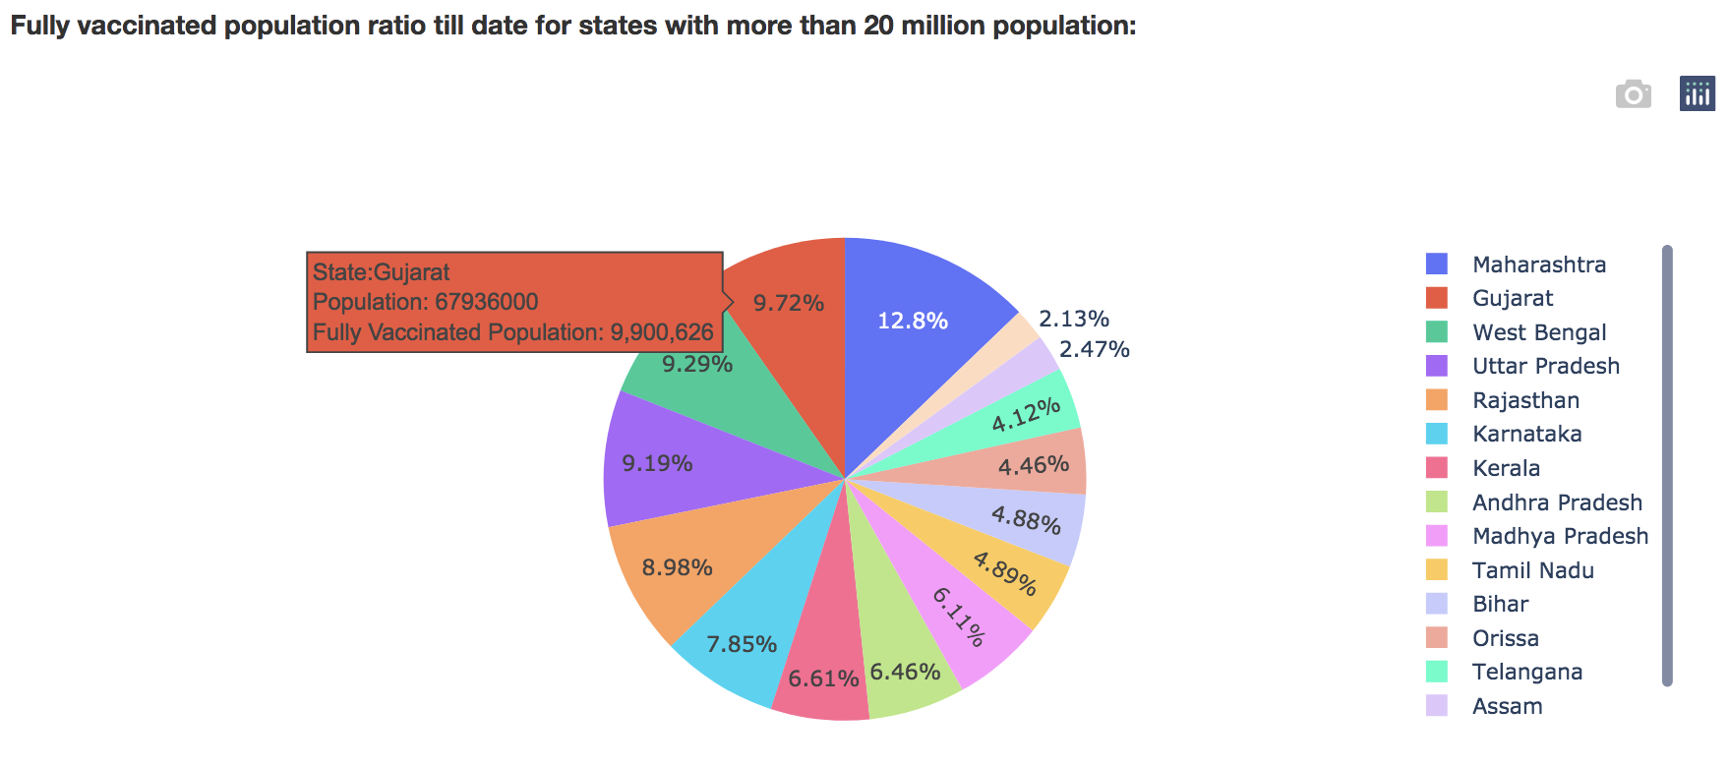
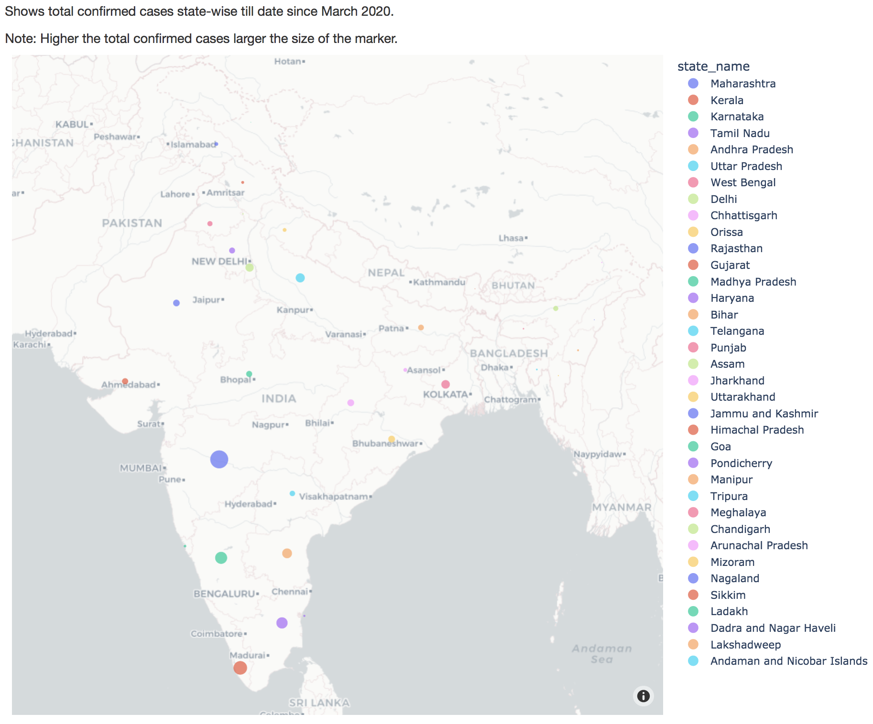
EDA Key Findings and Screenshots
Total percentage of the Fully (2 doses) vaccinated population state-wise
State-wise map tracker to get the total confirmed cases on interactive hover-over

Slide 12
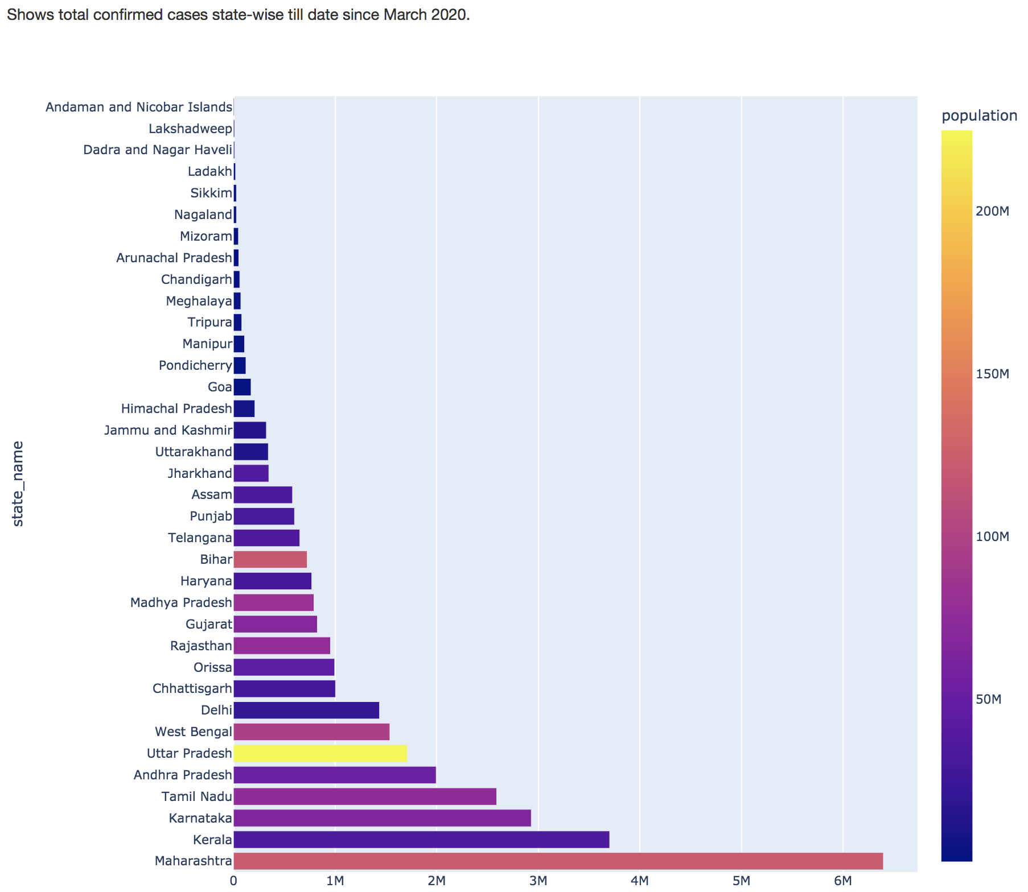
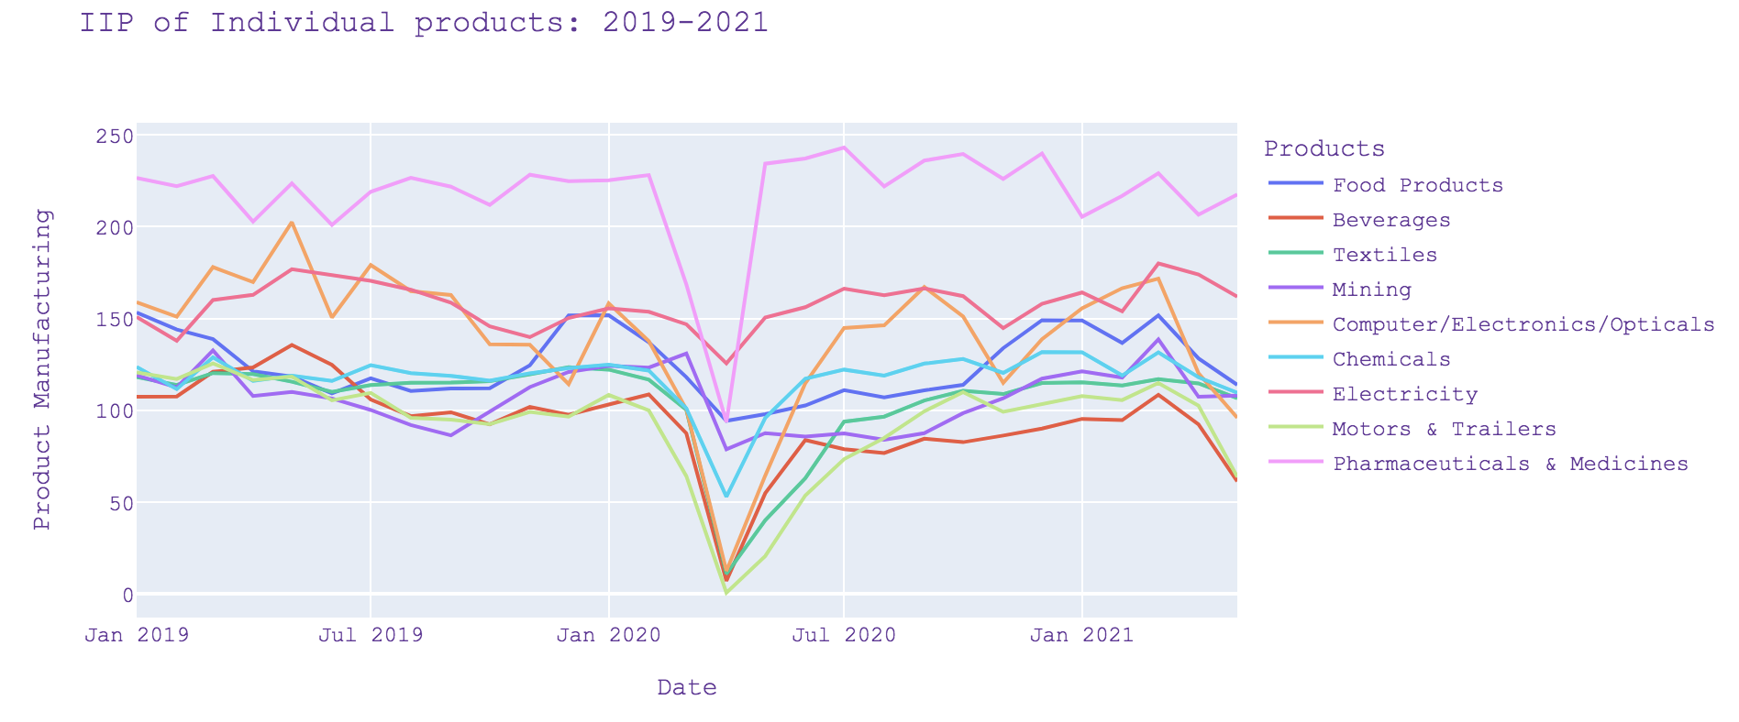
EDA Key Findings and Screenshots
Products-wise analysis on economic analysis: graph with trend of the production rates
Total confirmed cases till date state-wise

Slide 13
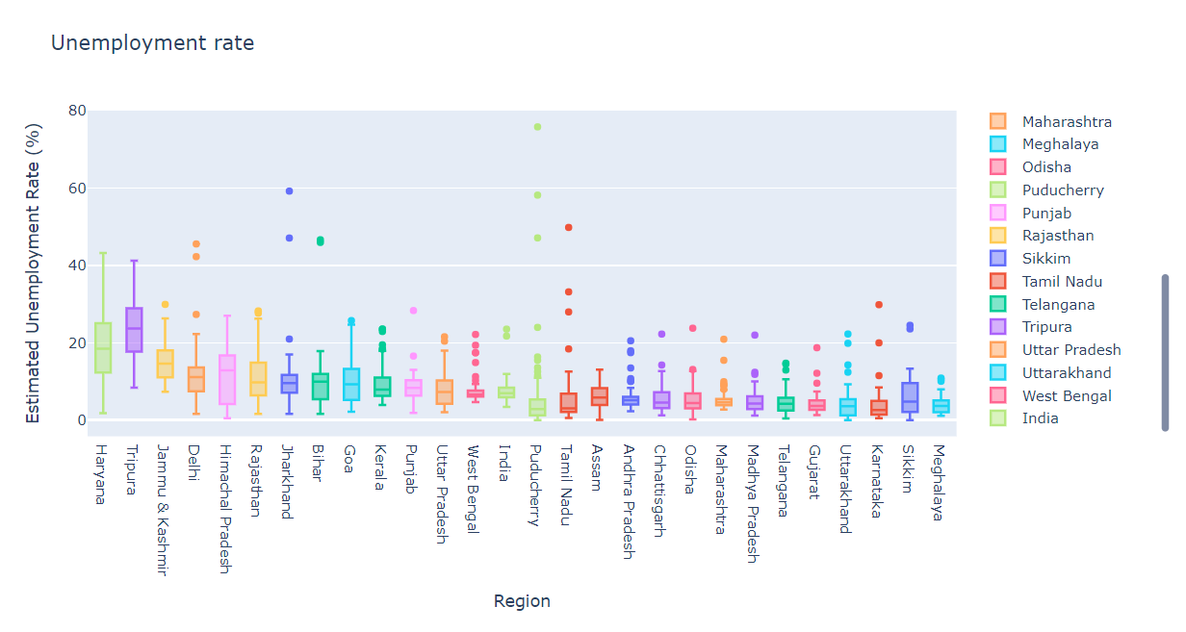
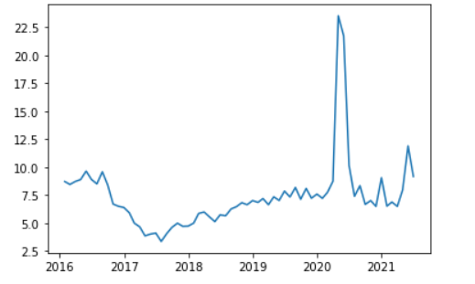
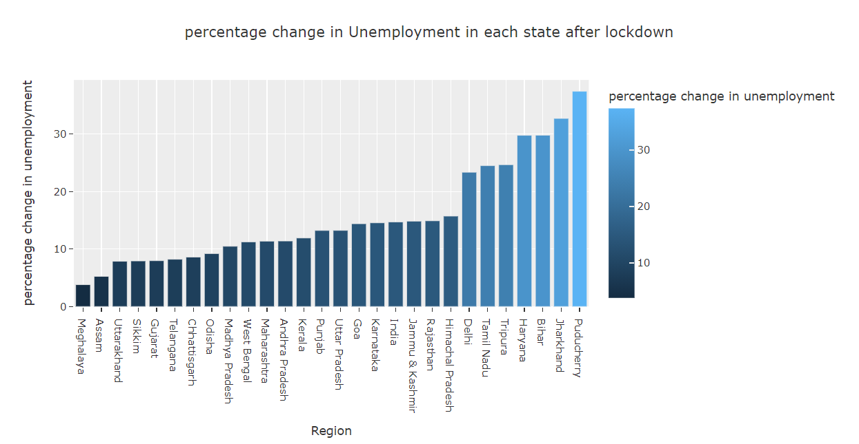
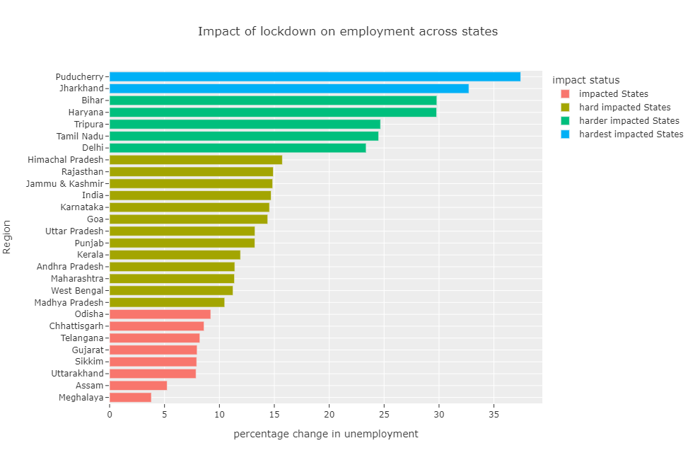
The rate has been going up in states/UTs of Pondicherry, Jharkhand, Tamil Nadu, Haryana and Delhi ( > 30%)
The impact is least in Meghalaya and Assam (< 10%)
The well developed states could compensate and manage the impact in a better way than the under- developed areas of India

Slide 14
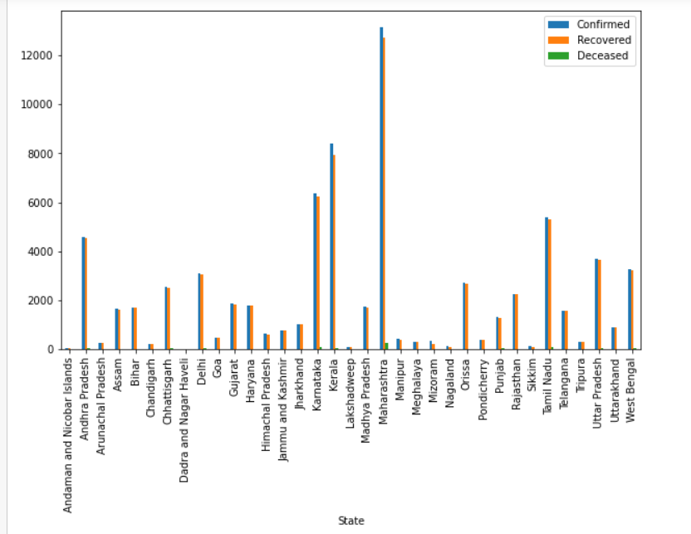
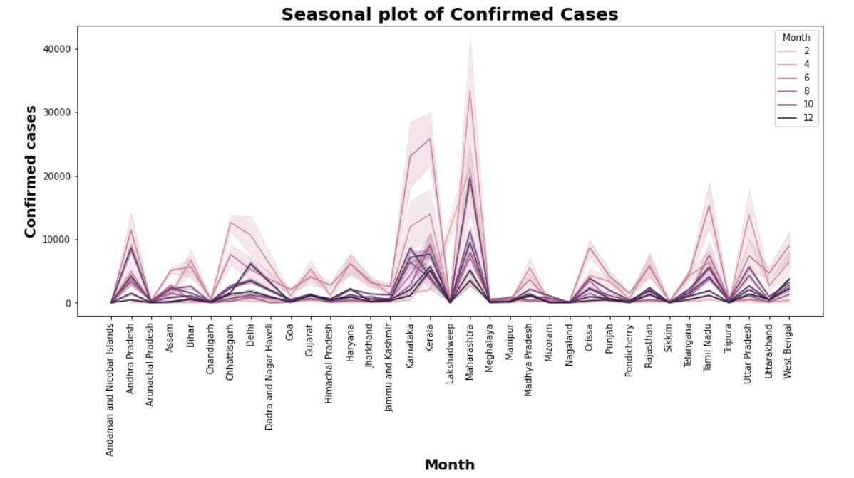
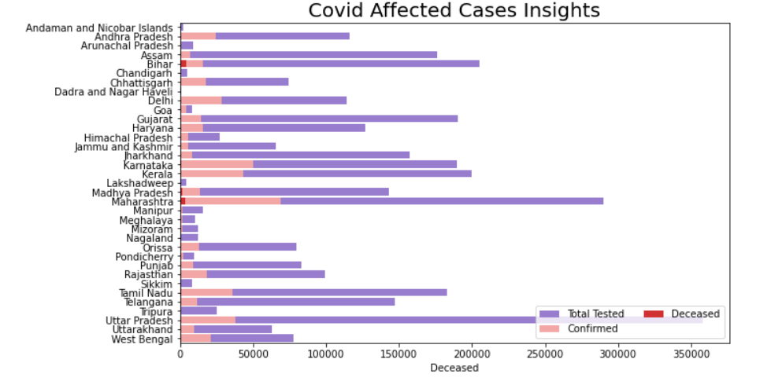
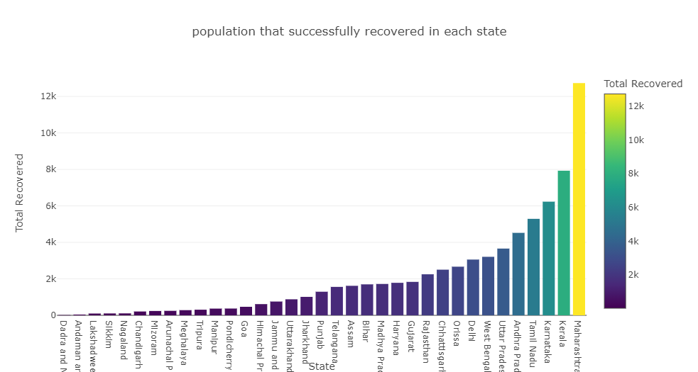
The cases have been increasing since March'20, reached a peak in May’21 and started falling there on.
Maximum number of Corona Positive Cases/Deaths/Recovered Cases have been observed in Maharashtra
Minimum number of Corona Positive Cases/Deaths/Recovered Cases have been observed in Dadra and Nagar Haveli
The most hardly hit states were Maharashtra, Uttar Pradesh, Tamil Nadu and Kerala
The north-eastern regions of Mizoram and Sikkim could cope up well

Slide 15
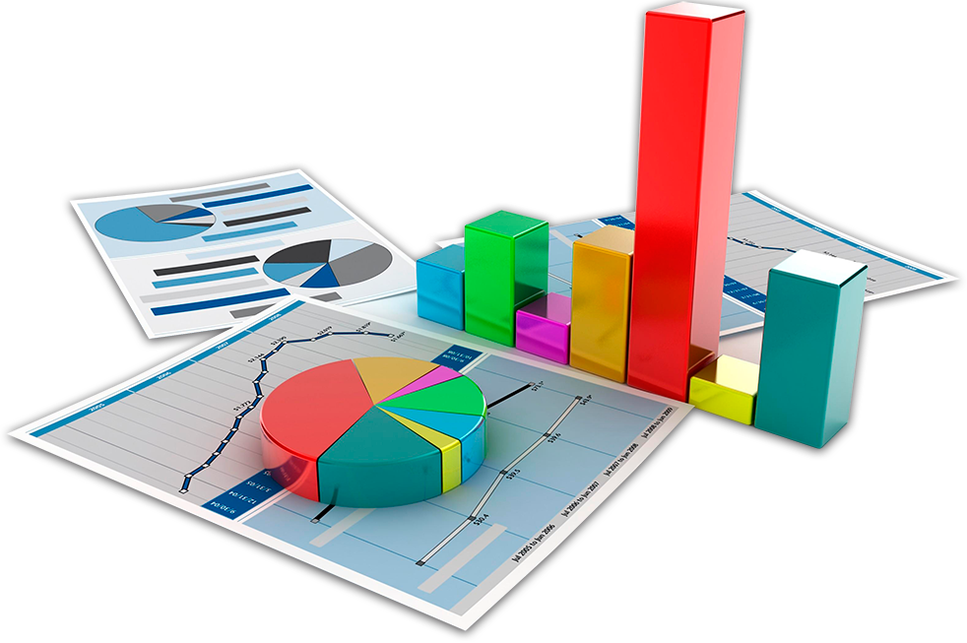
Modelling Phase

Slide 16
Time-Series Forecasting and web-app integration
Time-Series Forecasting Models Data Collection:
Made use of real time data from one of the github repos for vaccination-data and
Scraped data from several sites and also made use of covid-api (source:).
Converted json data received from api to csv in order to feed data to models.
Data Pre-Processing: The data obtained was then munged , cleaned and moulded according to our needs for each model requirement. The data preparation was mandatory.
Forecasting Methods : After data preprocessing, it was time for preparation of models.The main models we used are ARIMA/ARIMAX/FbProphet . The inference and predictions were collected by each of these models and used to analyse and get insights from our data.
Streamlit web-App for Prediction Models: The I/P date given to model gives the prediction up till present date and shows a interactive graph with exact figures as well.

Slide 17
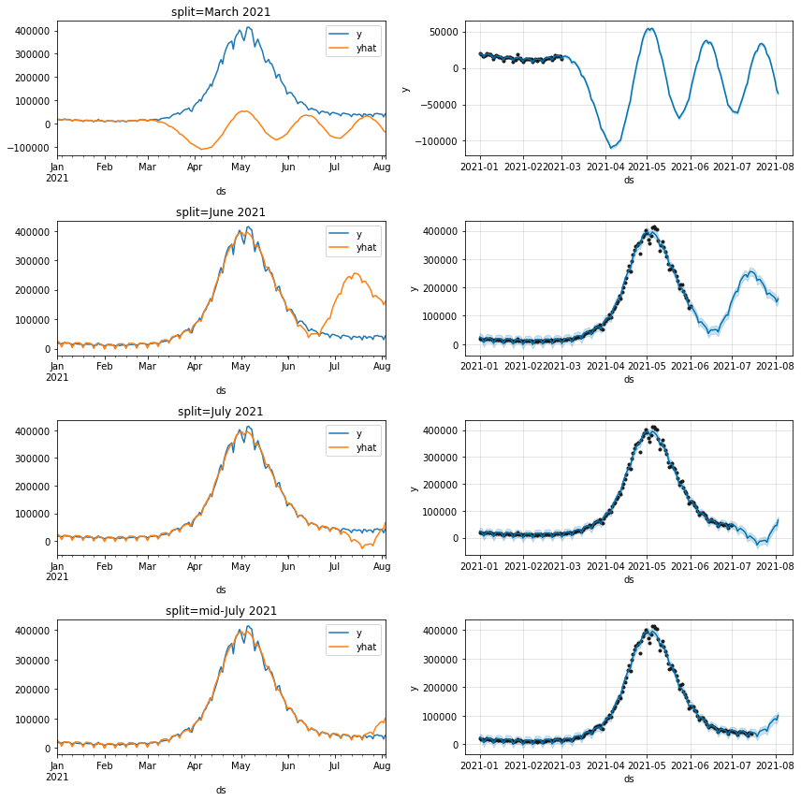
CONFIRMED CASES FORECAST
Our data over 2020 & 2021 is non-stationary while for 2021 it is stationary
In either of the models, as we provide more training set, the accuracy of prediction increases
Since there is no fixed trend that has been observed over 2020 & 2021 as a whole, each of the models perform better when trained on only 2021 dataset
Performance of fbProphet model is much better than that of ARIMA model

Slide 18
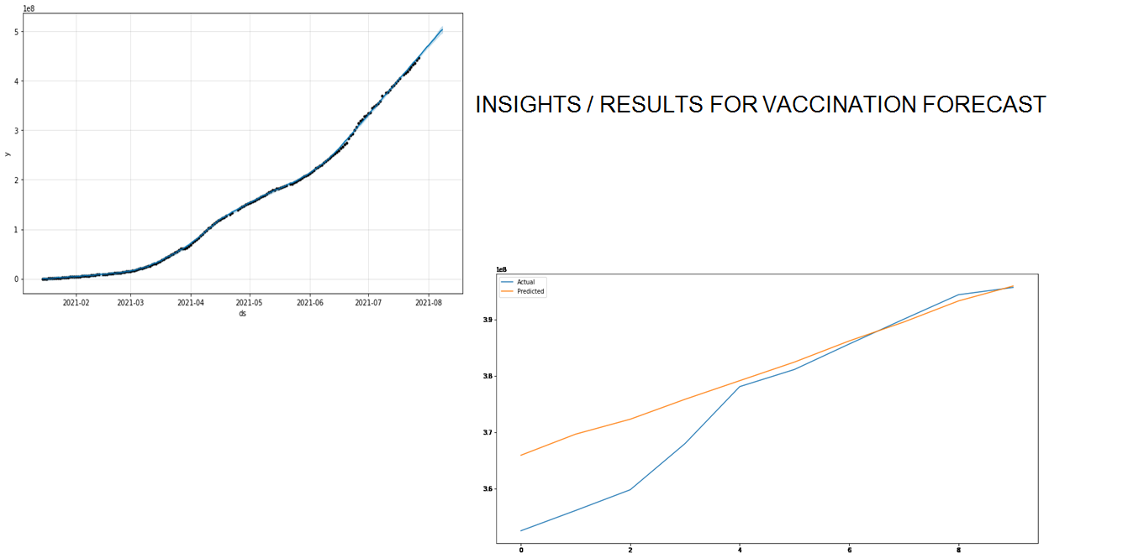
The FbProphet model was being used for the prediction of vaccination and doses given to people.
It forecasts to which date how many doses would be administered. The forecast rate is as shown :

Slide 19
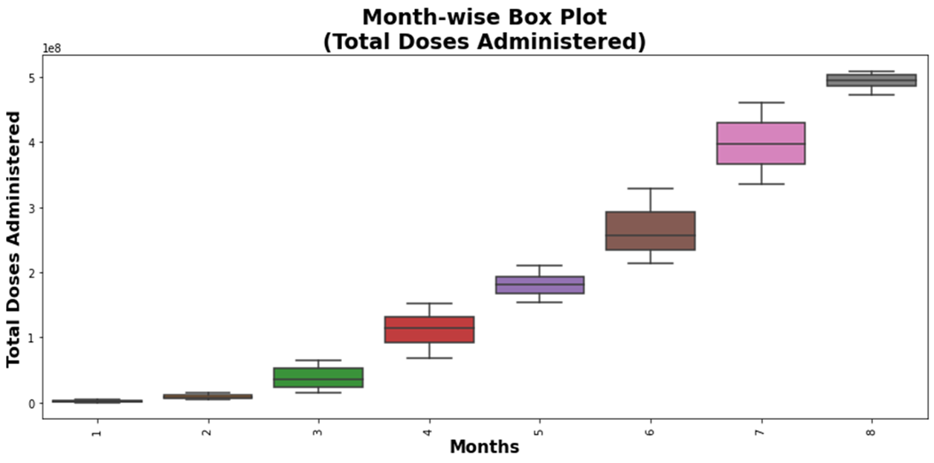

Slide 20
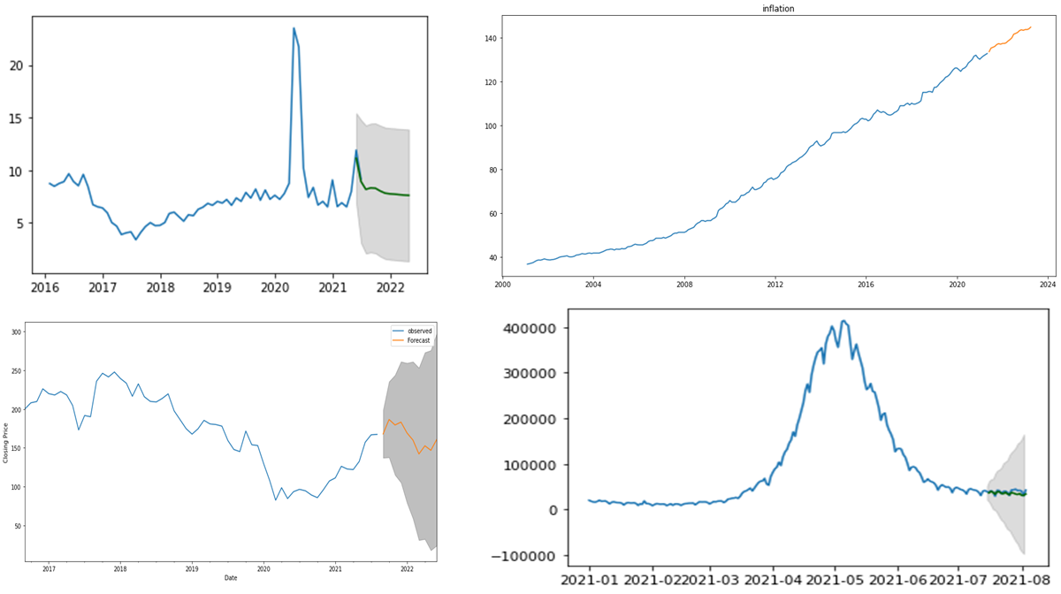
UNEMPLOYMENT RATE FORECAST
INFLATION FORECAST
OIL PRICES FORECAST
RECOVERED CASES FORECAST

Slide 21
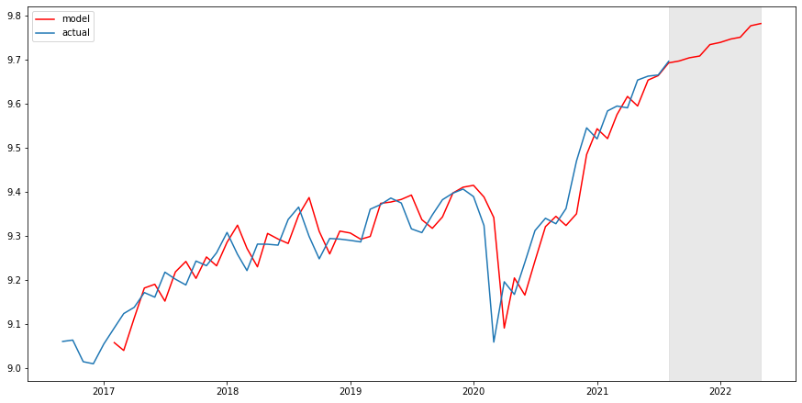
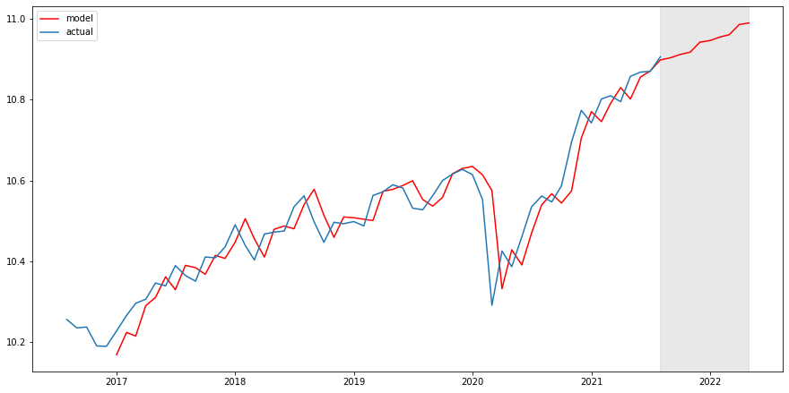
NIFTY STOCKS FORECAST
SENSEX STOCKS FORECAST

Slide 22
Image and Text Classification Model
1.Image Classification and object detection on CT Scan images.
Used Transfer Learning methodology for object detection and classification.
The Dataset used was SIIM-FISABIO-RSNA COVID-19 Detection Dataset.
Model name: YOLOv5, metric: mAP 42.2
YOLOv5 is a family of compound-scaled object detection models trained on the COCO dataset, and includes simple functionality for Test Time Augmentation (TTA), model ensembling, hyperparameter evolution, and export to ONNX, CoreML and TFLite.
2.NLP classification model to identify covid based on symptoms.
Variables: The variables in the dataset were- cough, fever, sore-throat, shortness of breath, headache, age above 60 or not and gender.
Target Variable: corona_result (0 or 1).
Classification: Ensemble Learning using multiple XGBoost Model.

Slide 23
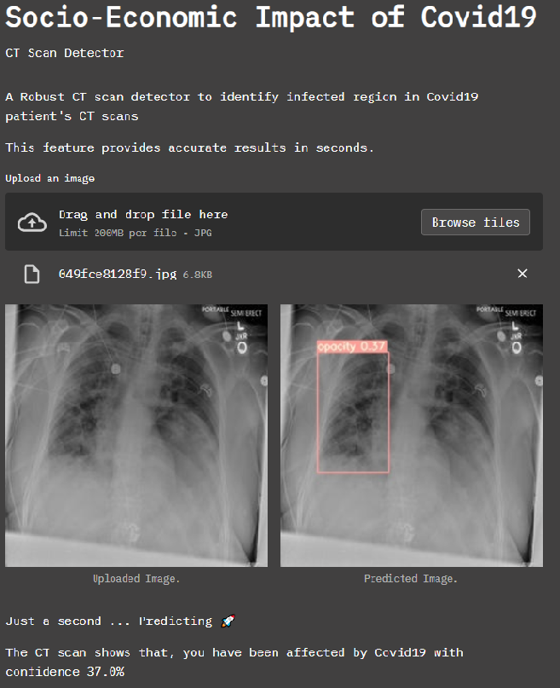
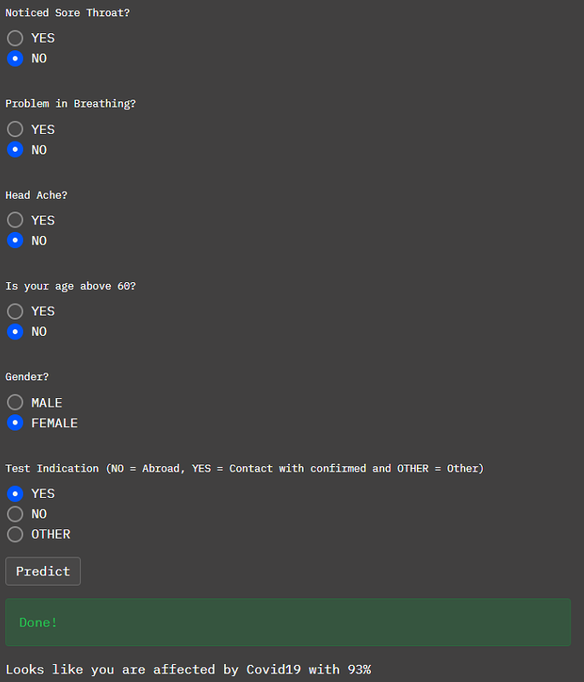
1.Covid CT scan Image Classification and Detection.
2. Covid Symptoms Text Classification.

Slide 24
Twitter tweet Sentiment Analysis and web-app
Twitter Tweet Data Collection
Real-Time: Twitter API with StreamListener() Class was used to generate real-time
tweets when executed as a .py script based on Track/search terms e.g. Corona, Covid.
Historical: Used IEEE dataset that provides tweetIDs by month/day.. The full text of
the tweet was obtained by hydrating the TweetID using Twarc
Tweet Pre-Processing: Full text of tweets (real-time or historical) were “cleaned” to remove emojis, non-alphabet characters, punctuations, mentions, hashtags.
Sentiment Analysis: Following cleaning of input text, tweets the tokenized and submitted to the LSTM model for training in batches with a specific sequence length. The model was evaluated in a validation set to tune hyperparameters. Following a test accuracy of 94% the weights were saved into a .pt file in pytorch for inference
Streamlit web-App for Sentiment: Input text from Real-time OR historical tweets from the streamlit app were submitted to the trained inference function for analysis to generate a response for positive or negative sentiment.

Slide 25
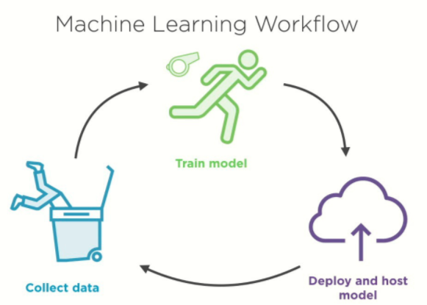
Deployment Phase

Slide 26

Streamlit Deployment Part 1

Slide 27
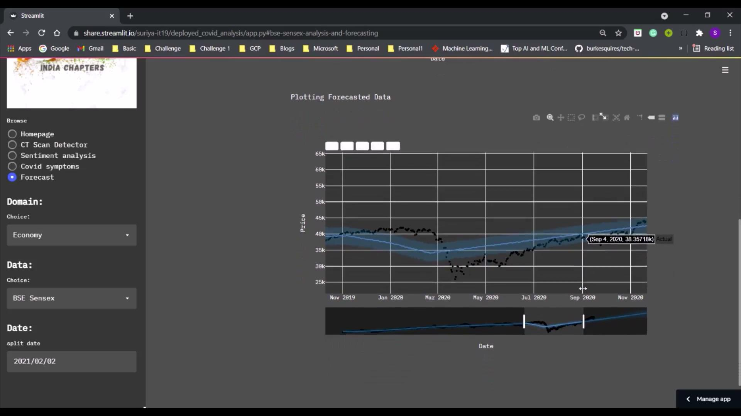
Streamlit Deployment Part 2

Slide 28
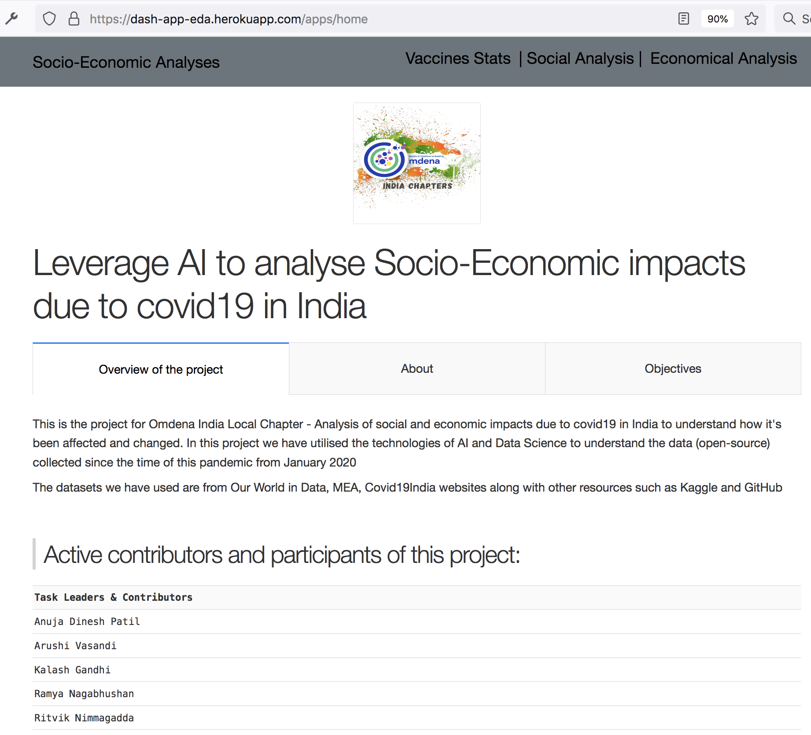
Dash App Deployment

Slide 29
Challenges and Future Scope
Challenges:
The main challenge we ran into is the deployment platform, not all providers are free and some has size
restriction, so we opted a scalable free server for deploying with no size limit
Version conflict between tasks, caused a problem in the final stage, which is solved using a container package
Future scope:
Updation in the layout will be considered first
Features for all sub tasks will be added in the future.
In addition to all this, one point is to combine social and economic factors to calculate overall gdp based on these factors.

Slide 30
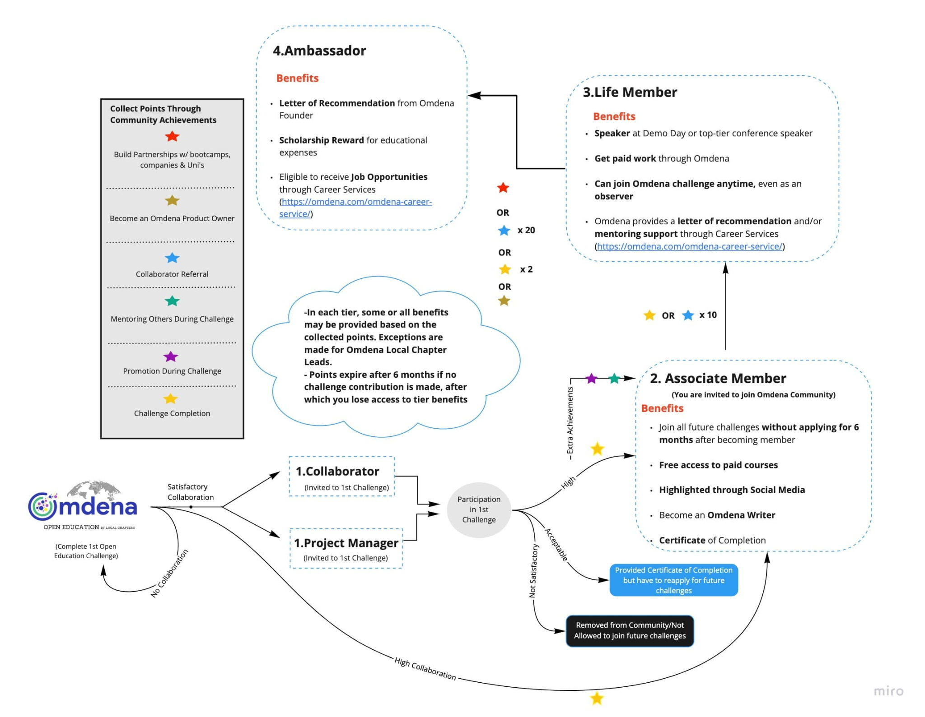

Slide 31


